Slide 1
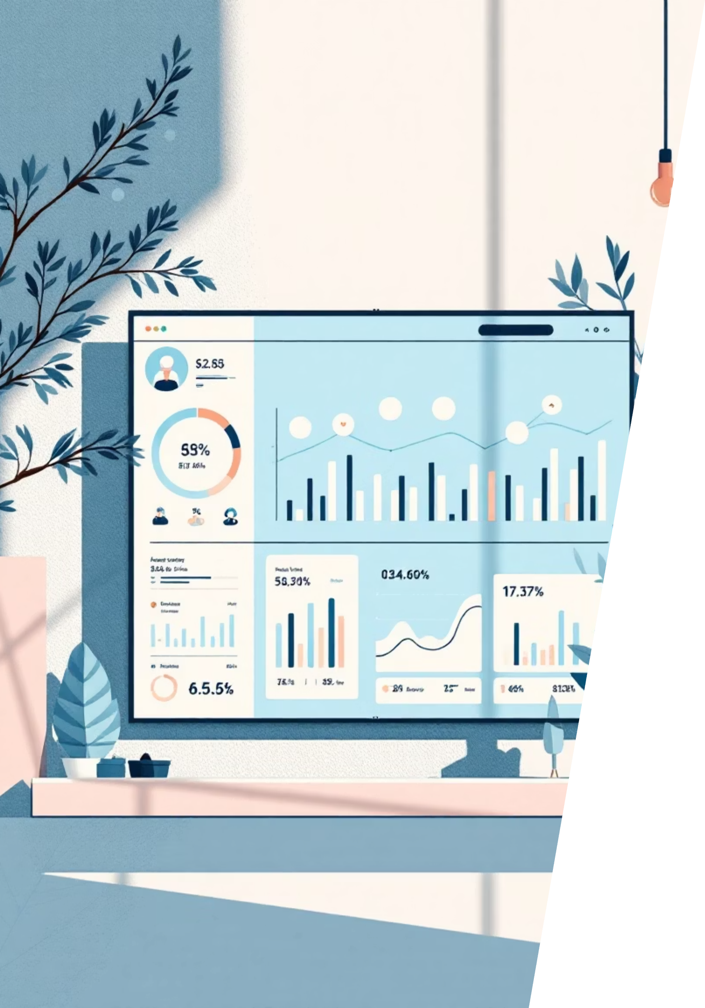
Customer Shopping Behavior Analysis
Analyzing 3,900 purchases across multiple product categories to reveal insights on spending trends, demographics, and shopping patterns that drive strategic business decisions.

Slide 2
Dataset Overview
3,900
18
25
50
Total Purchases
Data Points
Product Types
Locations
Comprehensive transactional data analyzed
Customer demographics, purchase details, and behavior metrics
Spanning clothing, accessories, footwear, and outerwear
Geographic diversity across customer base
Key features include customer demographics, purchase details, shopping behavior patterns, and review ratings with minimal missing data (37 entries).

Slide 3
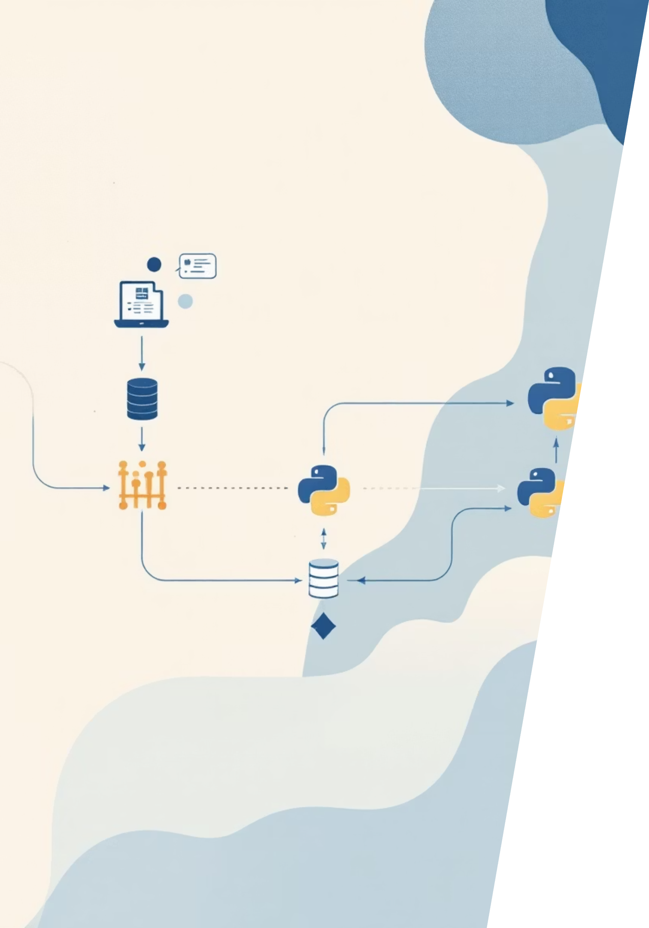
Data Preparation & Analysis Pipeline
01
Data Loading & Exploration
Imported dataset using pandas, performed initial structure analysis and summary statistics review
02
Data Cleaning
Handled missing values in Review Rating using median by category, standardized columns to snake case
03
Feature Engineering
Created age_group bins and purchase_frequency_days columns for deeper analysis
04
Database Integration
Connected to PostgreSQL and loaded cleaned data for structured SQL analysis

Slide 4
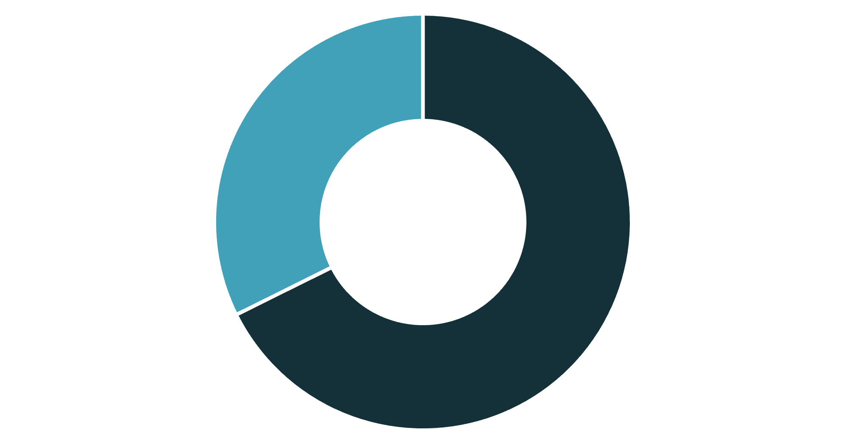
Revenue Analysis by Gender
Key Insight
Male customers generate 68% of total revenue, contributing $157,890 compared to $75,191 from female customers.
This significant disparity suggests opportunities for targeted marketing strategies to balance gender engagement.
Male
Female

Slide 5

Customer Spending Patterns
High-Value Discount Users
Shipping Preferences
Express shipping: $60.48 avg
Standard shipping: $58.46 avg
Customers using discounts while exceeding average purchase amounts demonstrate price-conscious yet high-spending behavior.
Minimal difference suggests shipping speed isn't a major spending driver.
Subscription Impact
Subscribers: $59.49 avg spend
Non-subscribers: $59.87 avg
1,053 subscribers vs 2,847 non-subscribers with similar spending patterns.

Slide 6


Top-Rated Products
77%
77%
76%
Gloves
Sandals
Boots
Highest average rating at 3.86 out of 5.0
Strong performance with 3.84 rating
Consistent quality at 3.82 rating
76%
76%
Hat
Skirt
Popular accessory with 3.80 rating
Well-received at 3.78 rating
These top-rated products should be prominently featured in marketing campaigns to capitalize on customer satisfaction.

Slide 7
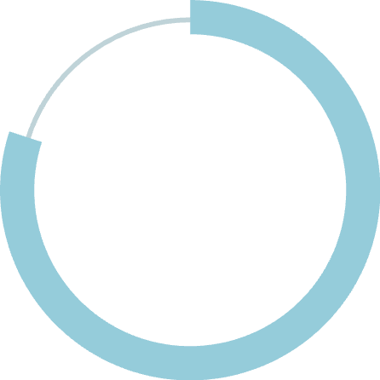
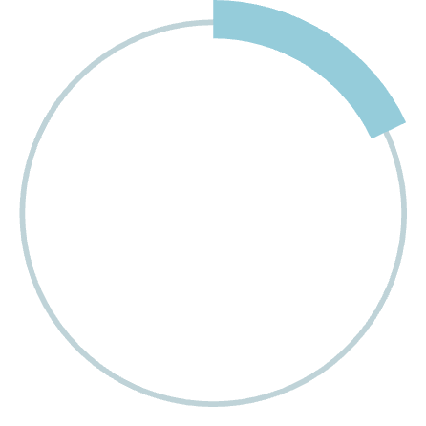

Customer Segmentation Analysis
Subscription Trends
Among repeat buyers (5+ purchases):
80%
2,518 are non-subscribers
958 have active subscriptions
Significant opportunity to convert loyal customers into subscribers through targeted incentives.
Loyal Customers
3,116 customers with consistent purchase history
18%
Returning
701 customers showing repeat behavior
2%
New Customers
83 first-time purchasers

Slide 8
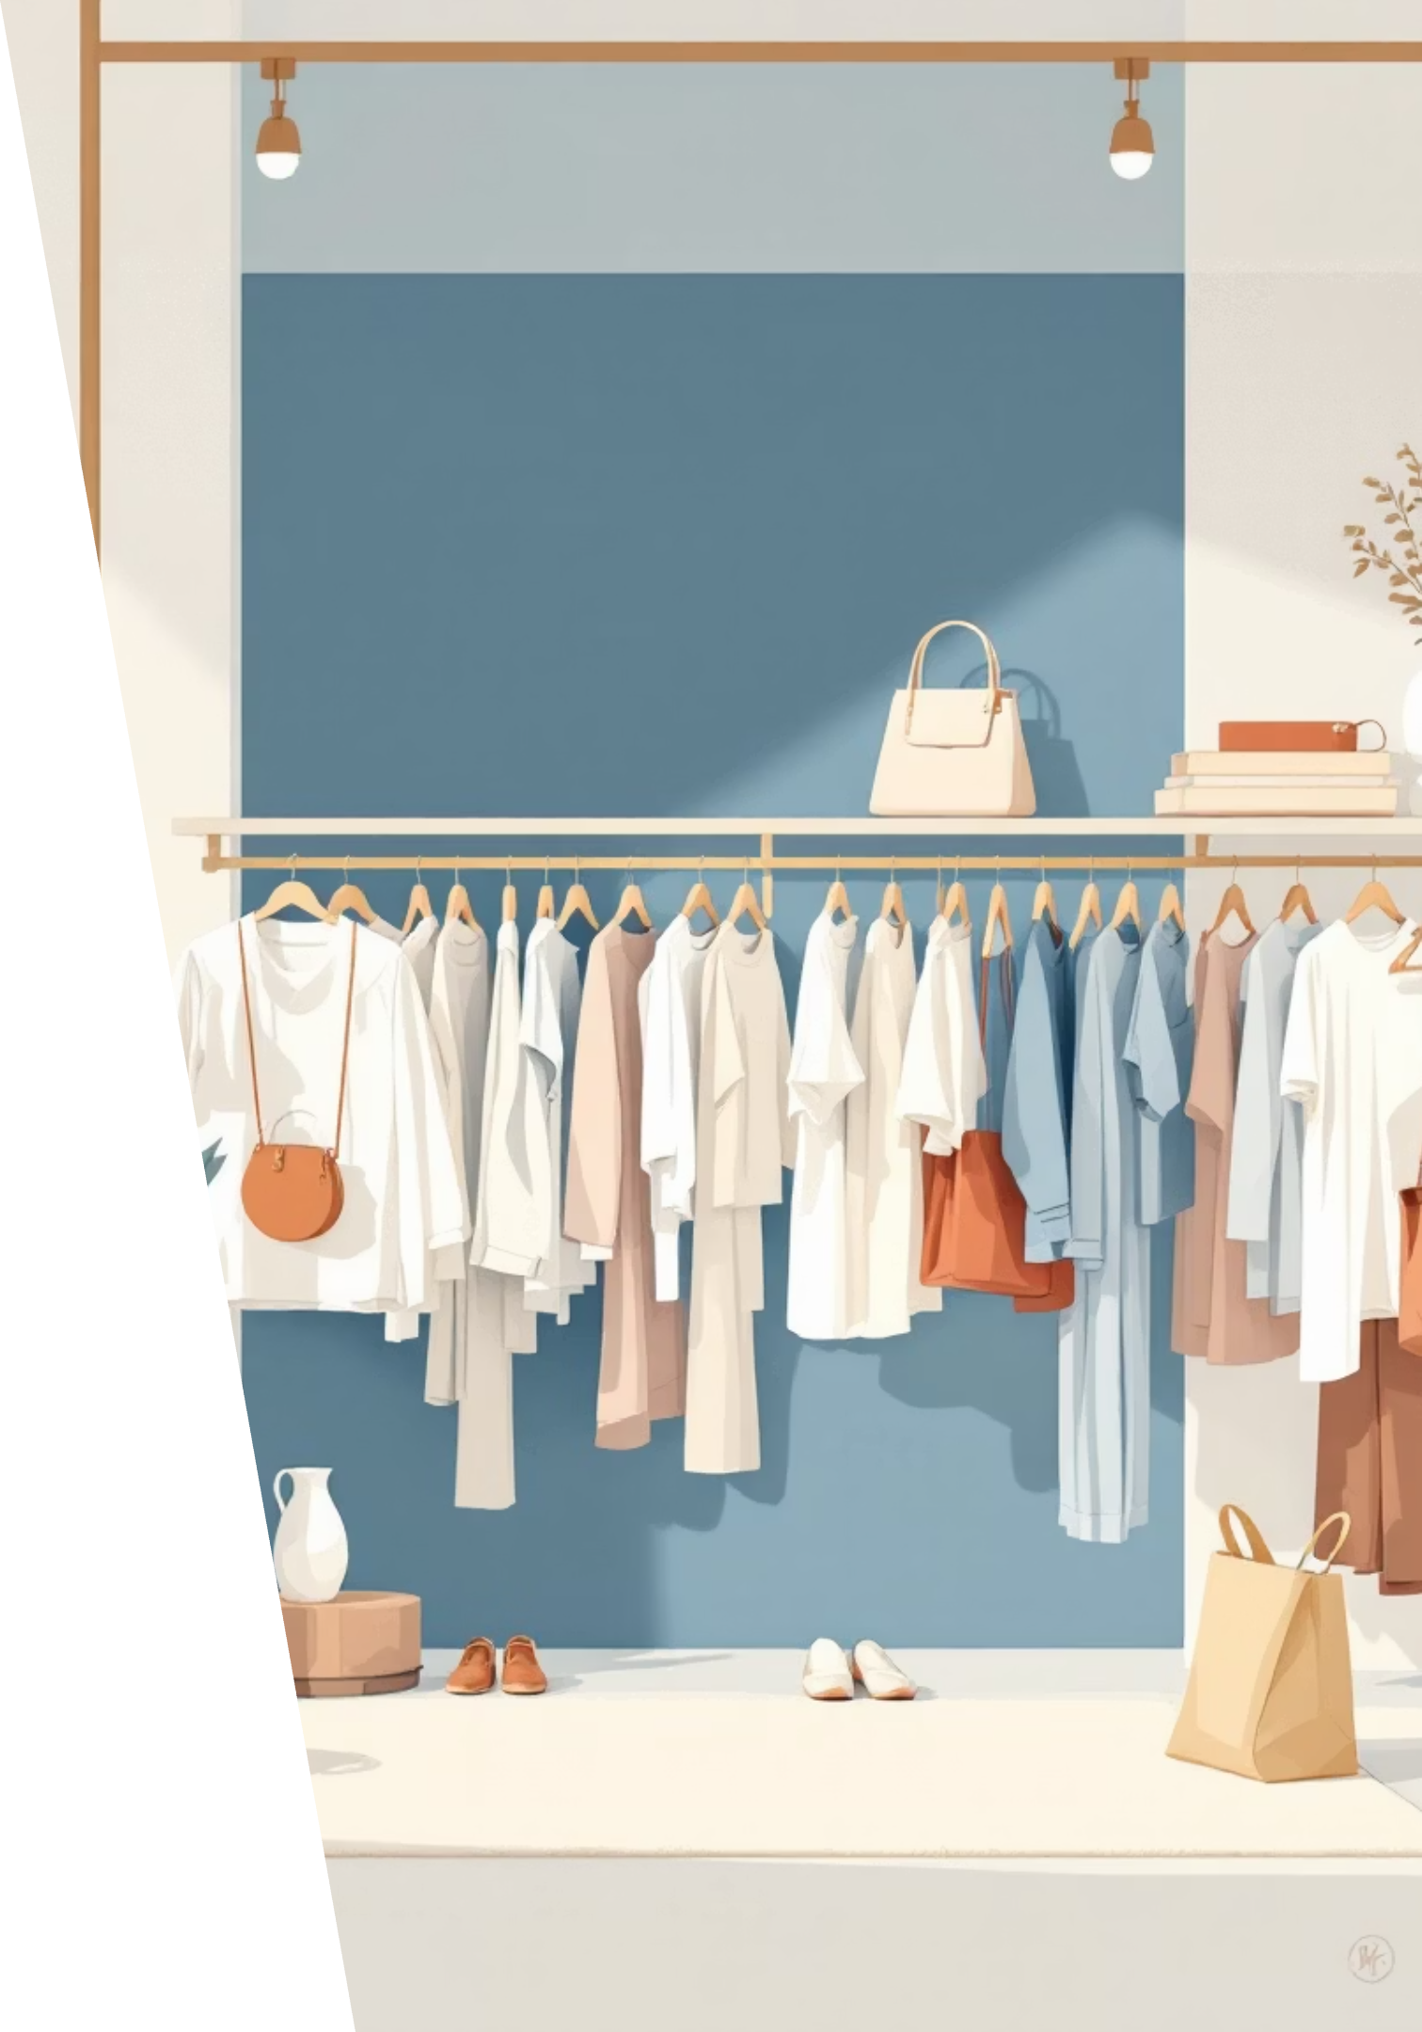
Product Performance by Category
Accessories
1
Top sellers: Jewelry (171 orders), Sunglasses (161), Belt (161)
Clothing
2
Top sellers: Blouse (171 orders), Pants (171), Shirt (169)
Footwear
3
Top sellers: Sandals (160 orders), Shoes (150), Sneakers (145)
Outerwear
4
Top sellers: Jacket (163 orders), Coat (161)

Slide 9
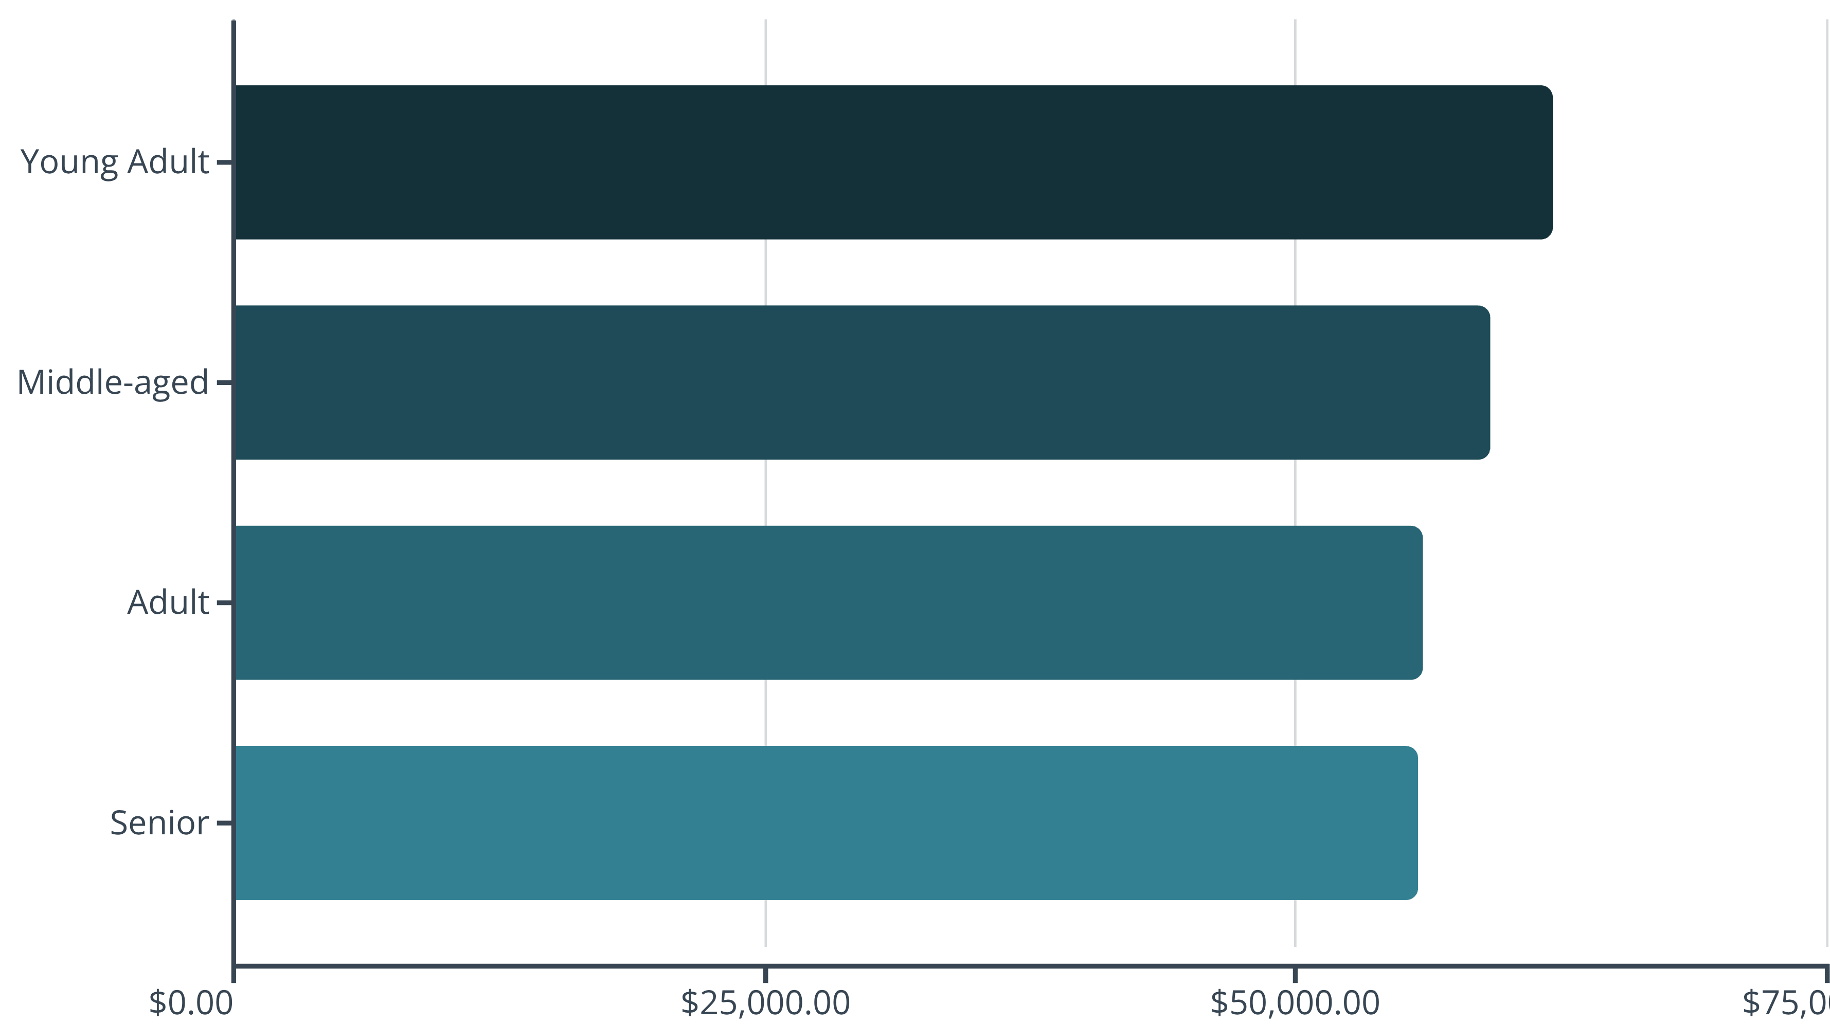
Revenue Distribution by Age Group
Young adults lead revenue generation at $62,143, followed closely by middle-aged customers. Relatively balanced distribution suggests broad market appeal across demographics.

Slide 10






Strategic Recommendations
Boost Subscriptions
Loyalty Programs
Optimize Discounts
Advertise unique benefits to convert 2,518 repeat buyers into subscribers, increasing customer lifetime value.
Incentivize returning customers to transition into the loyal segment through rewards and exclusive offers.
Balance sales increases with margin management—products like hats show 50% discount dependency.
Product Positioning
Targeted Marketing
Emphasize highest-rated products (gloves, sandals, boots) and top sellers in marketing campaigns.
Focus on young adult demographics and male customers who drive significant revenue contributions.

